Slide 3
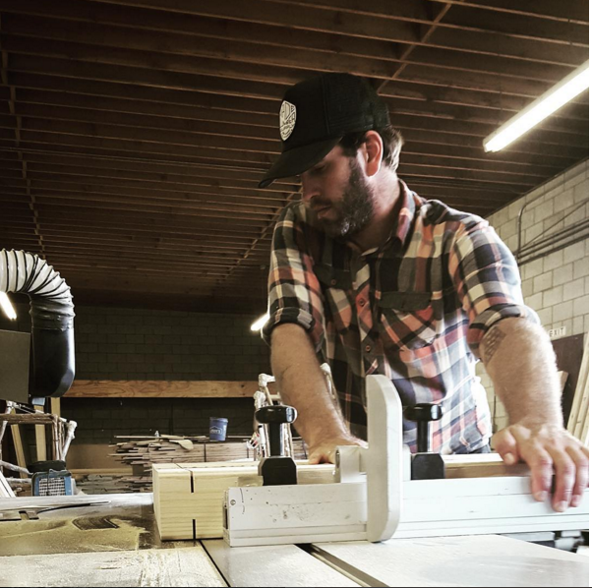
premier
dispensary
design
builds
installs

Slide 4


Slide 5
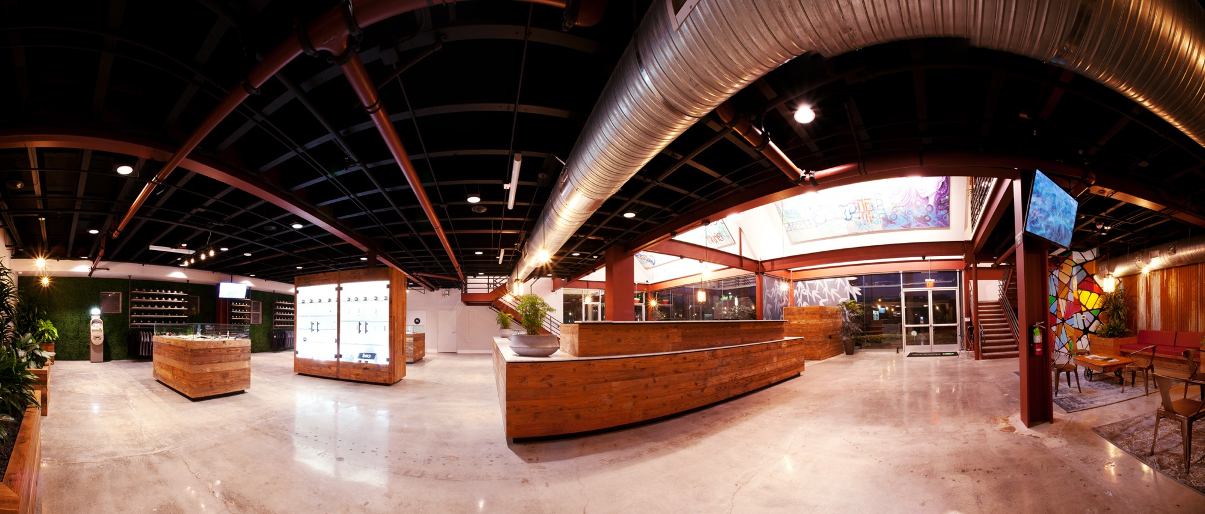

Slide 6
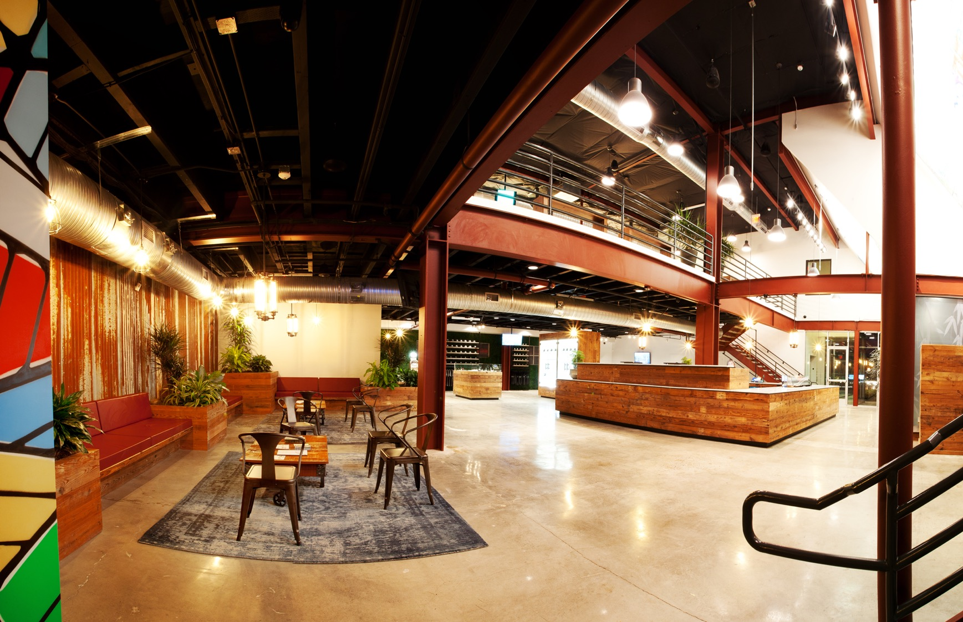

Slide 7
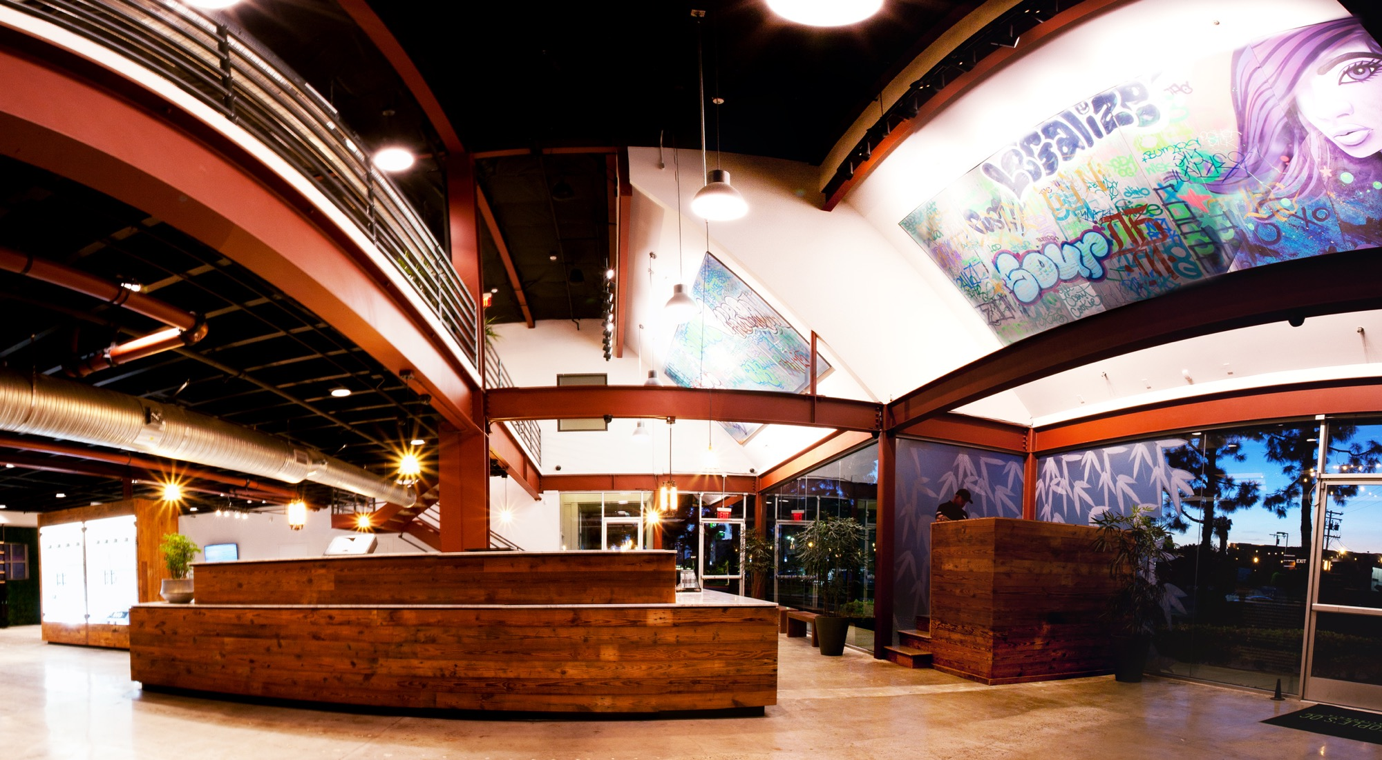

Slide 8
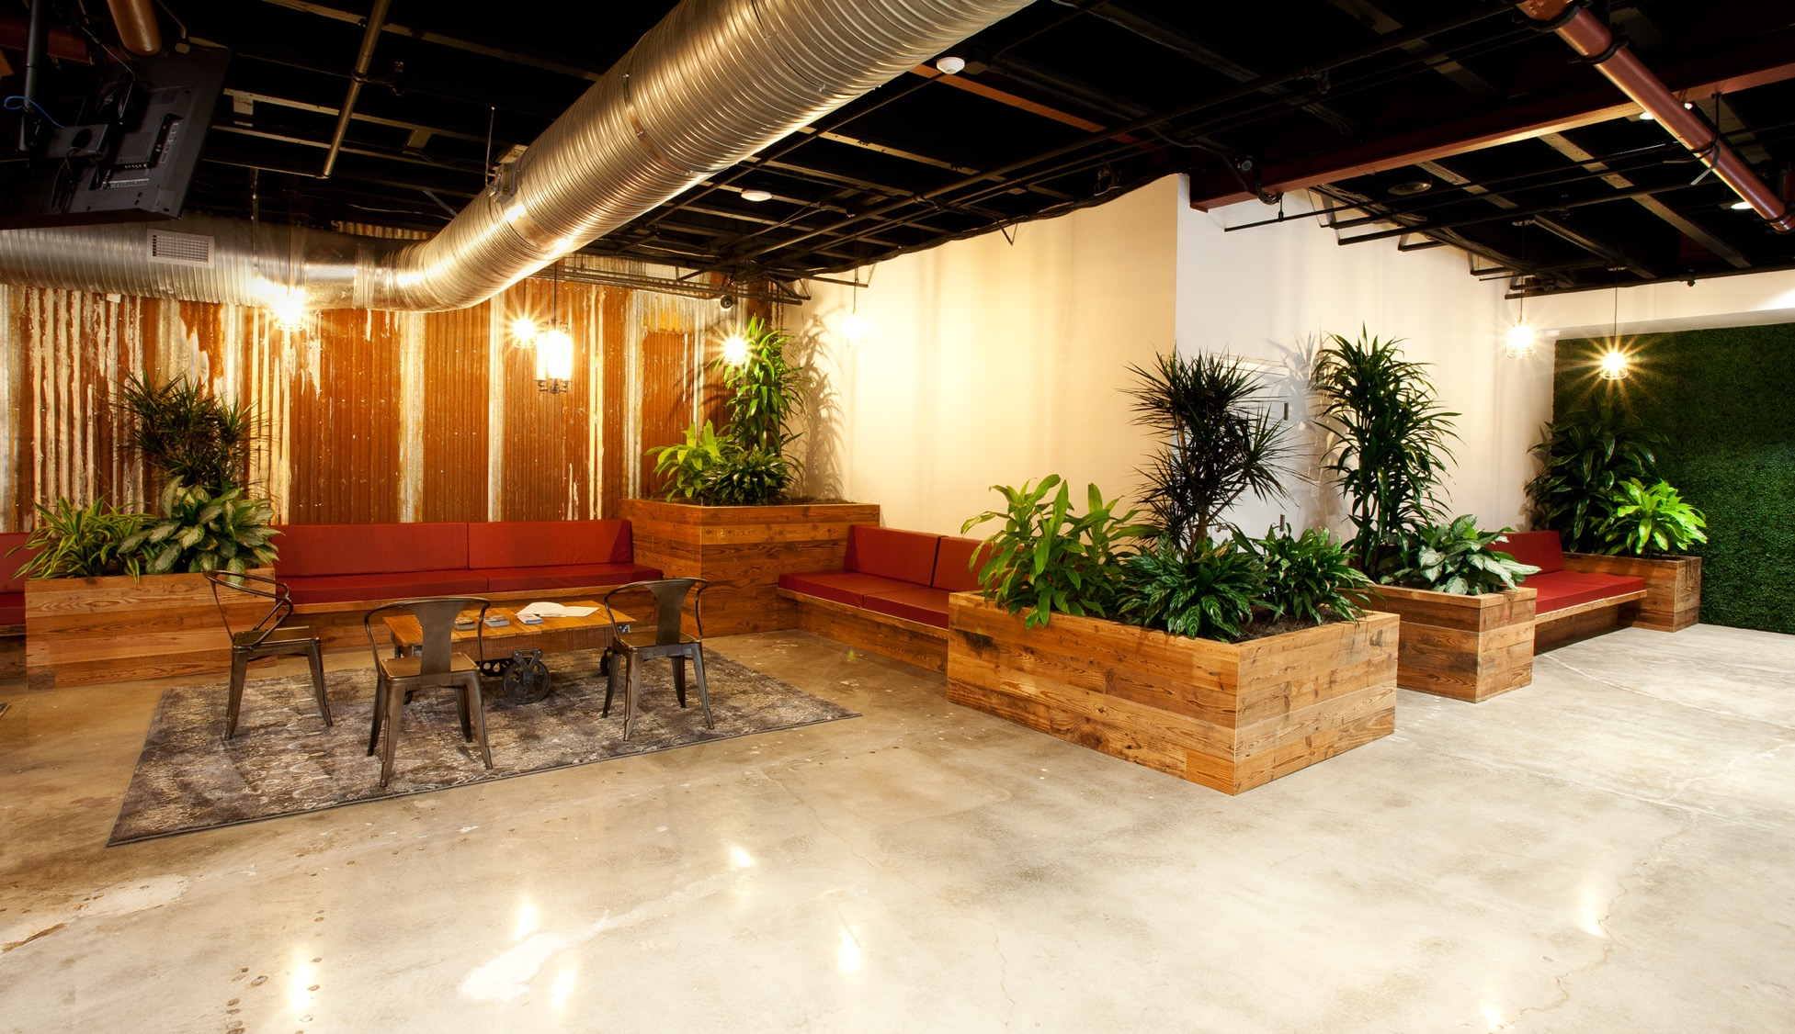

Slide 9
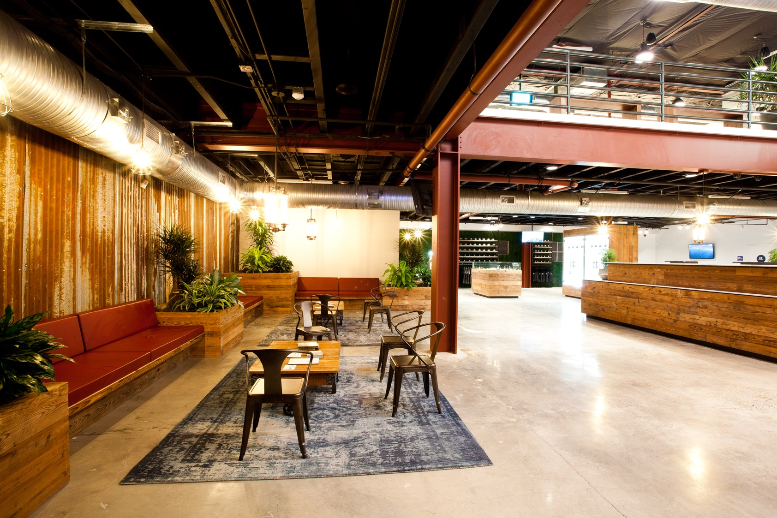

Slide 10
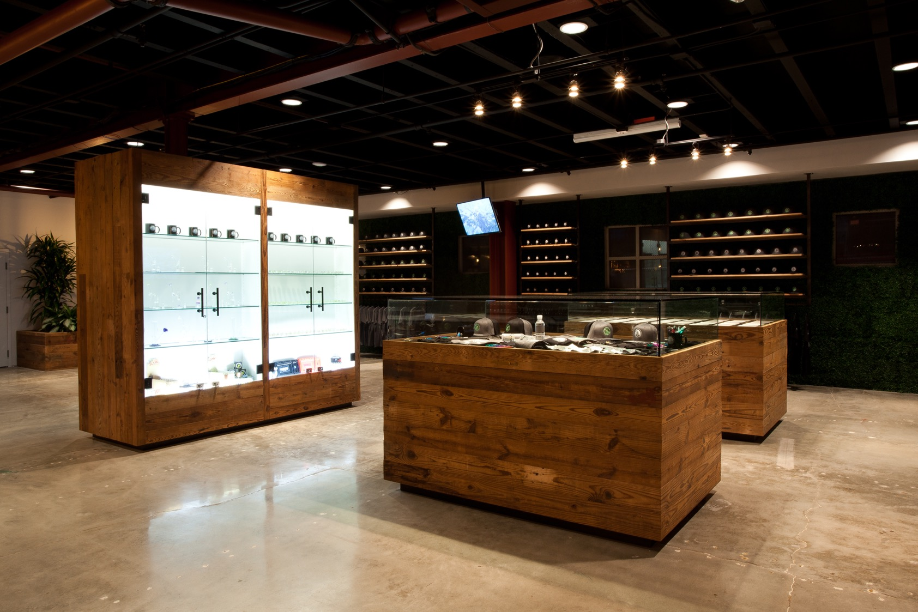

Slide 11
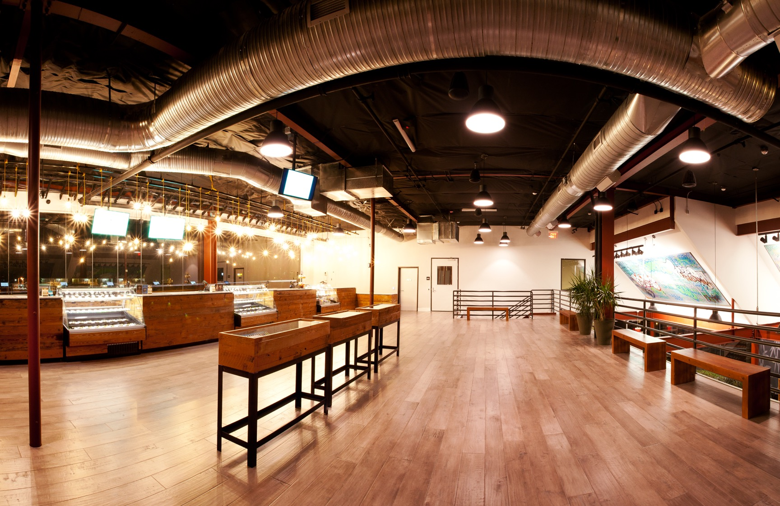

Slide 12
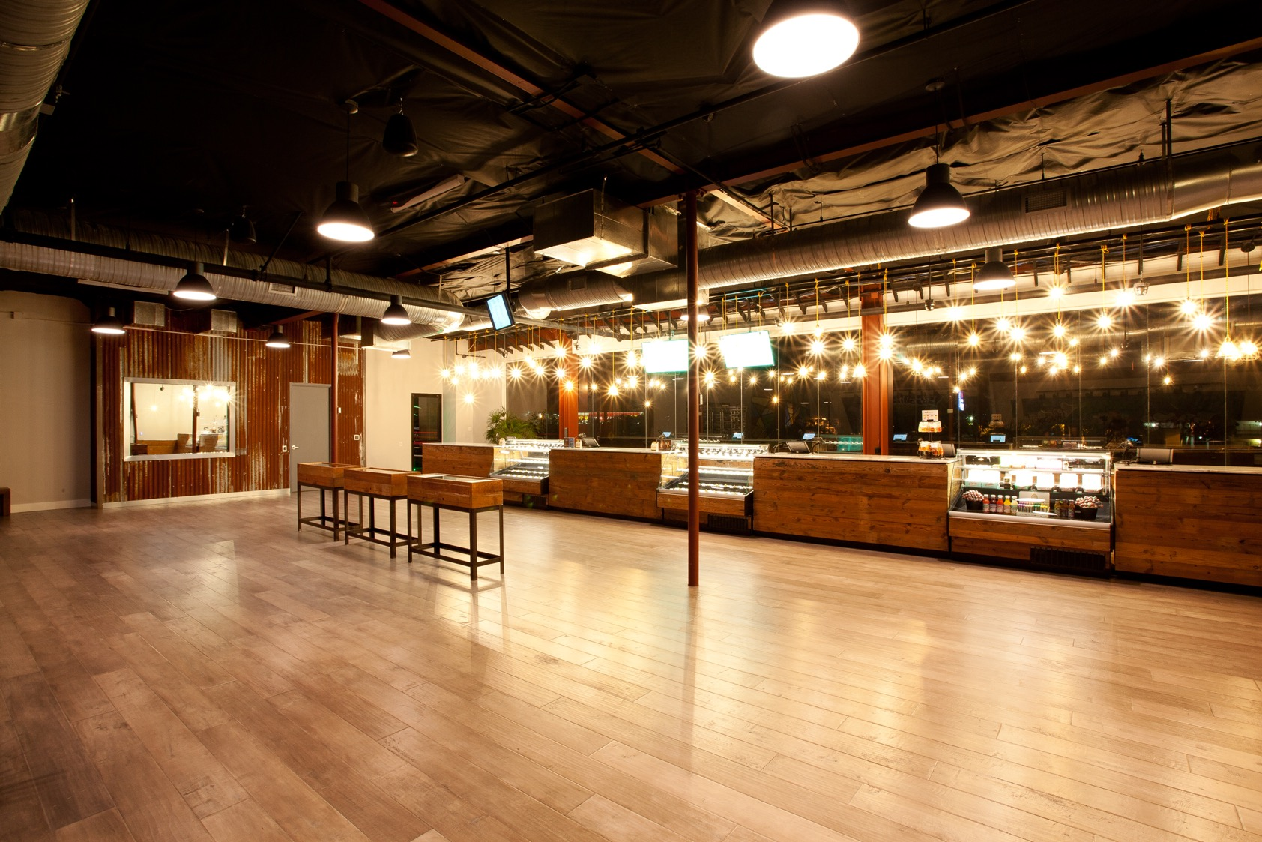

Slide 13
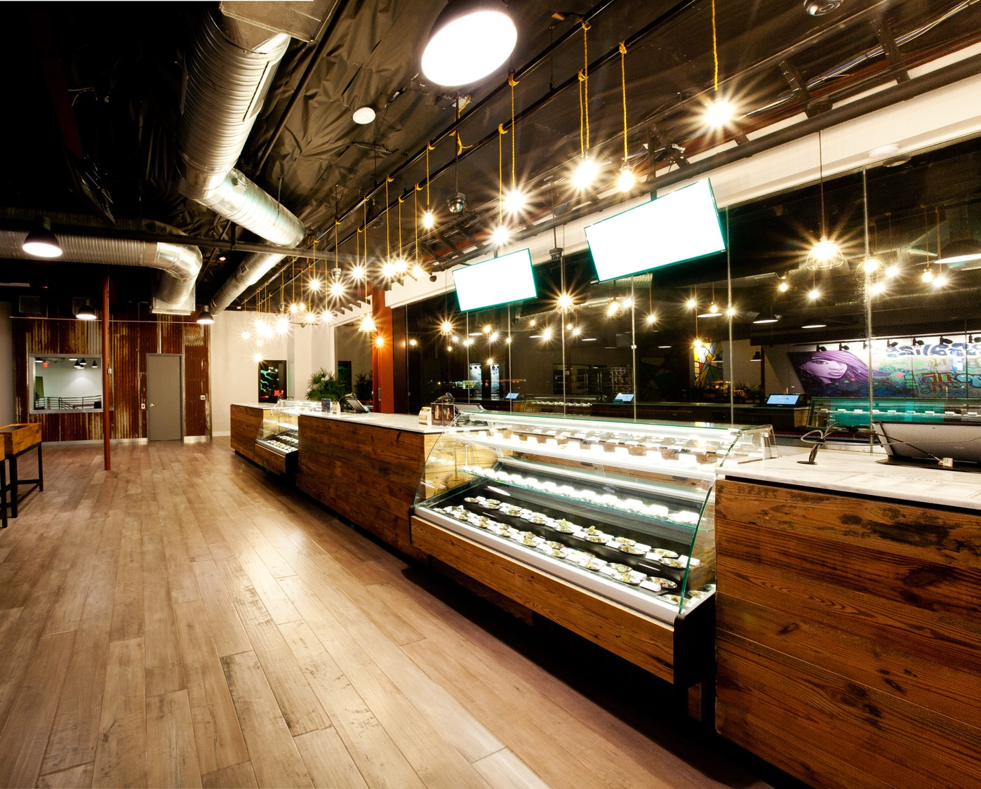

Slide 14
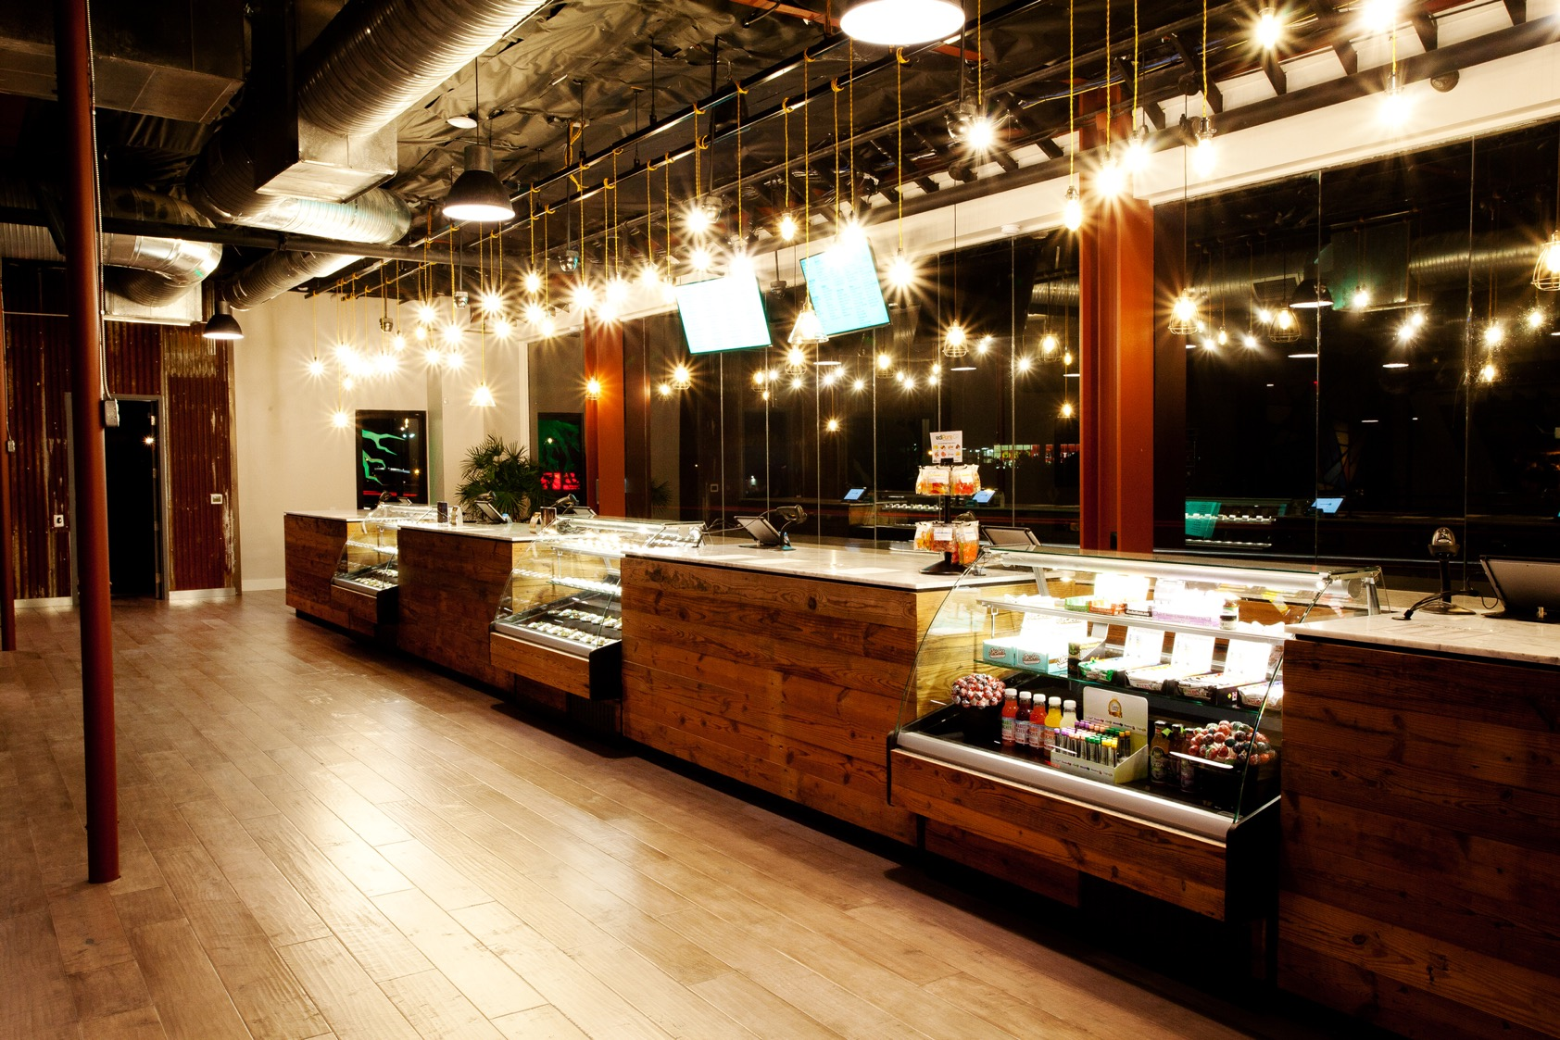

Slide 15
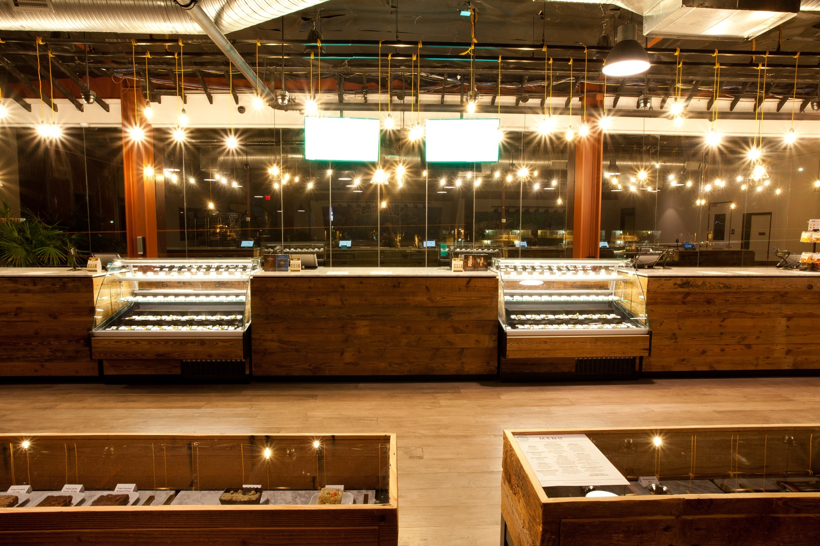

Slide 16
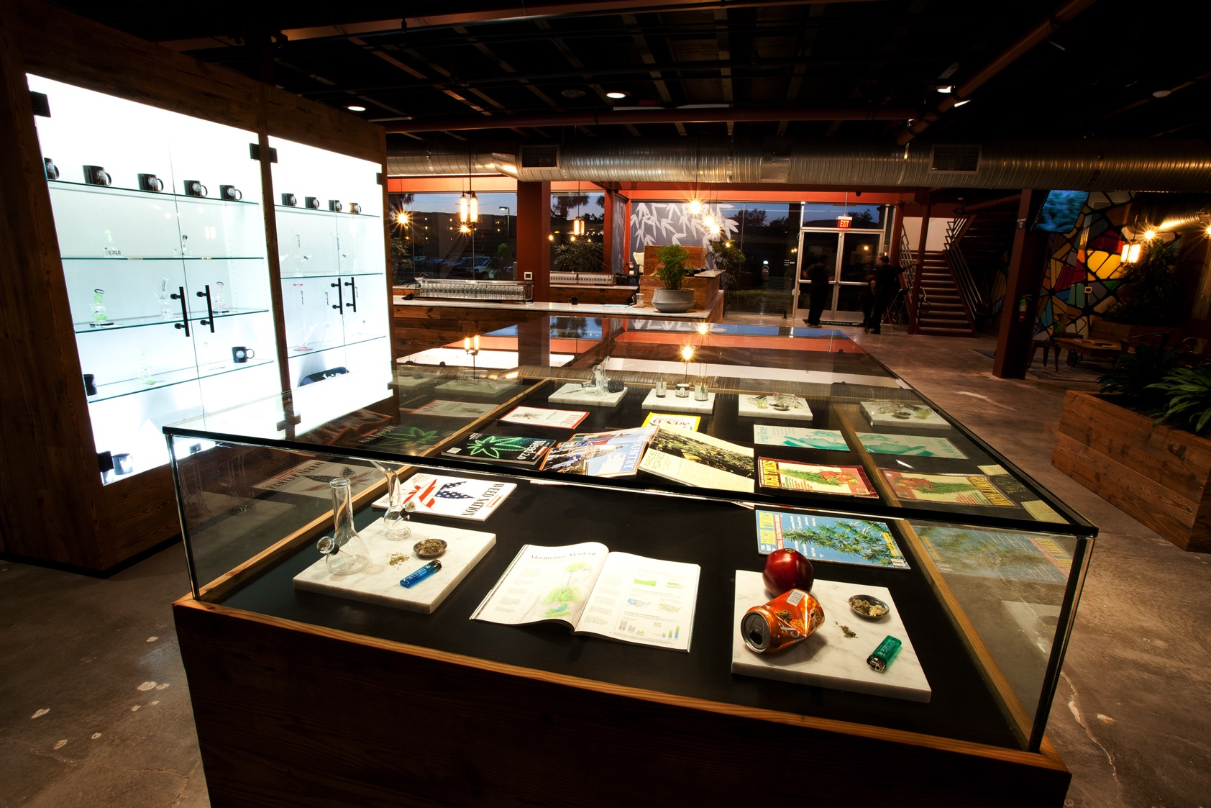

Slide 17
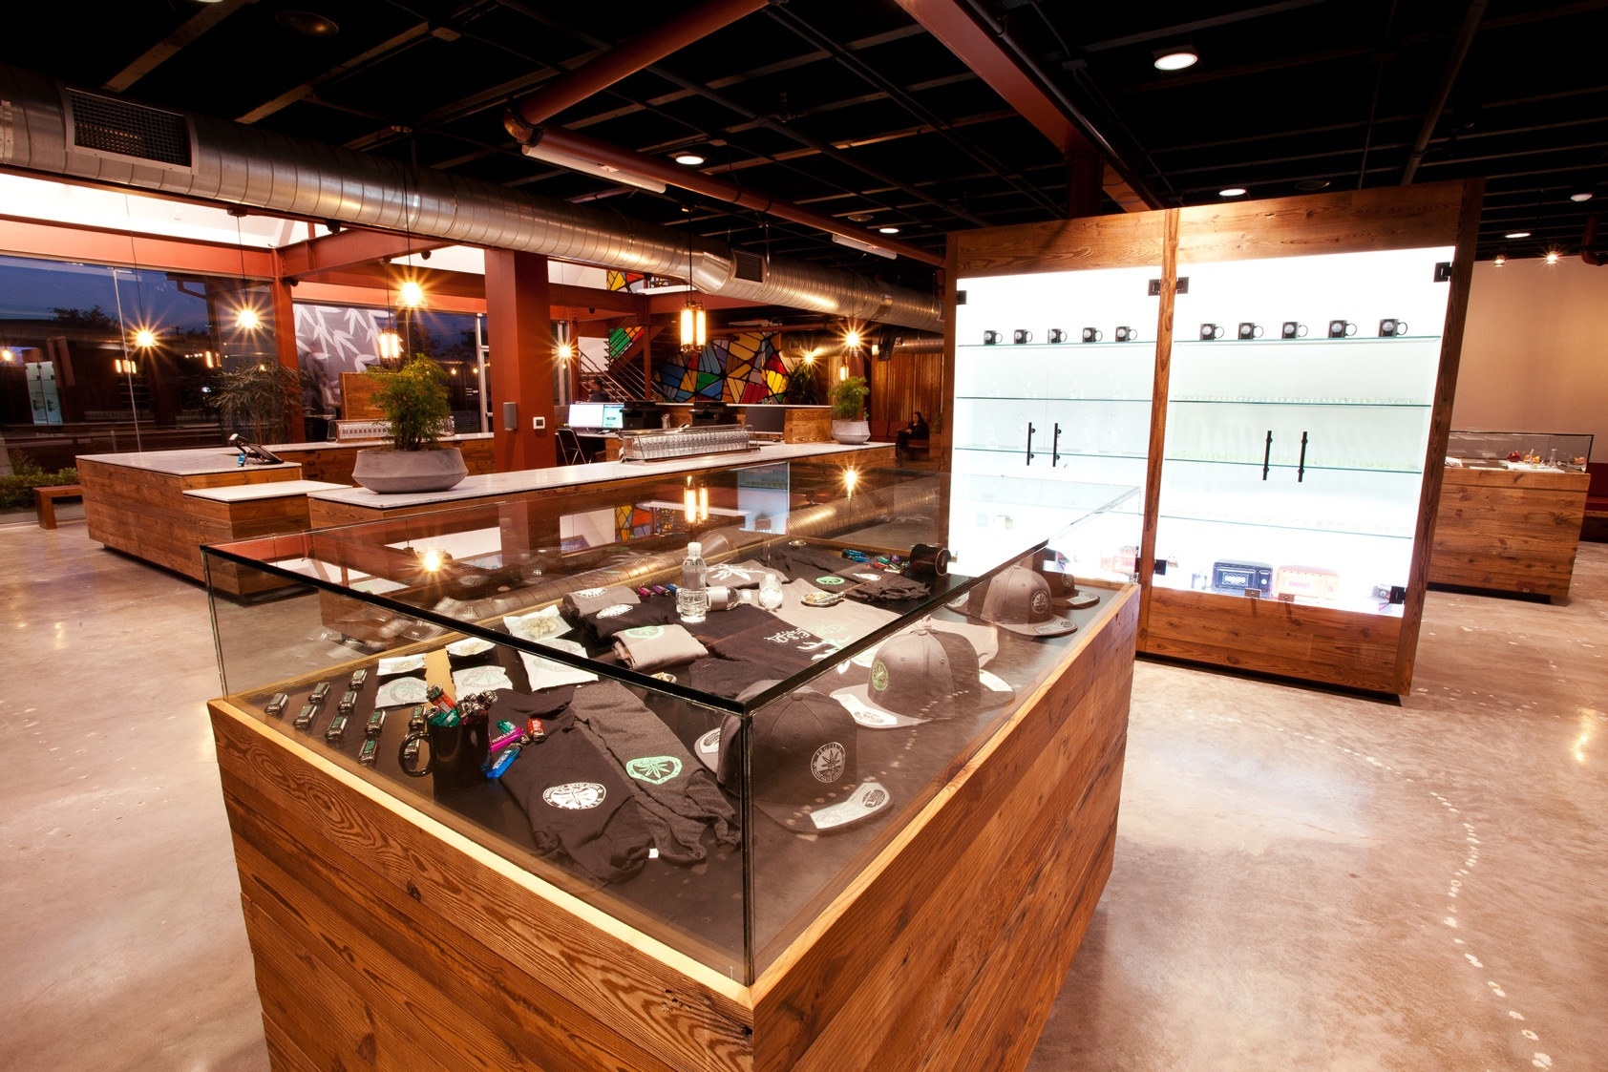

Slide 18


Slide 19


Slide 20
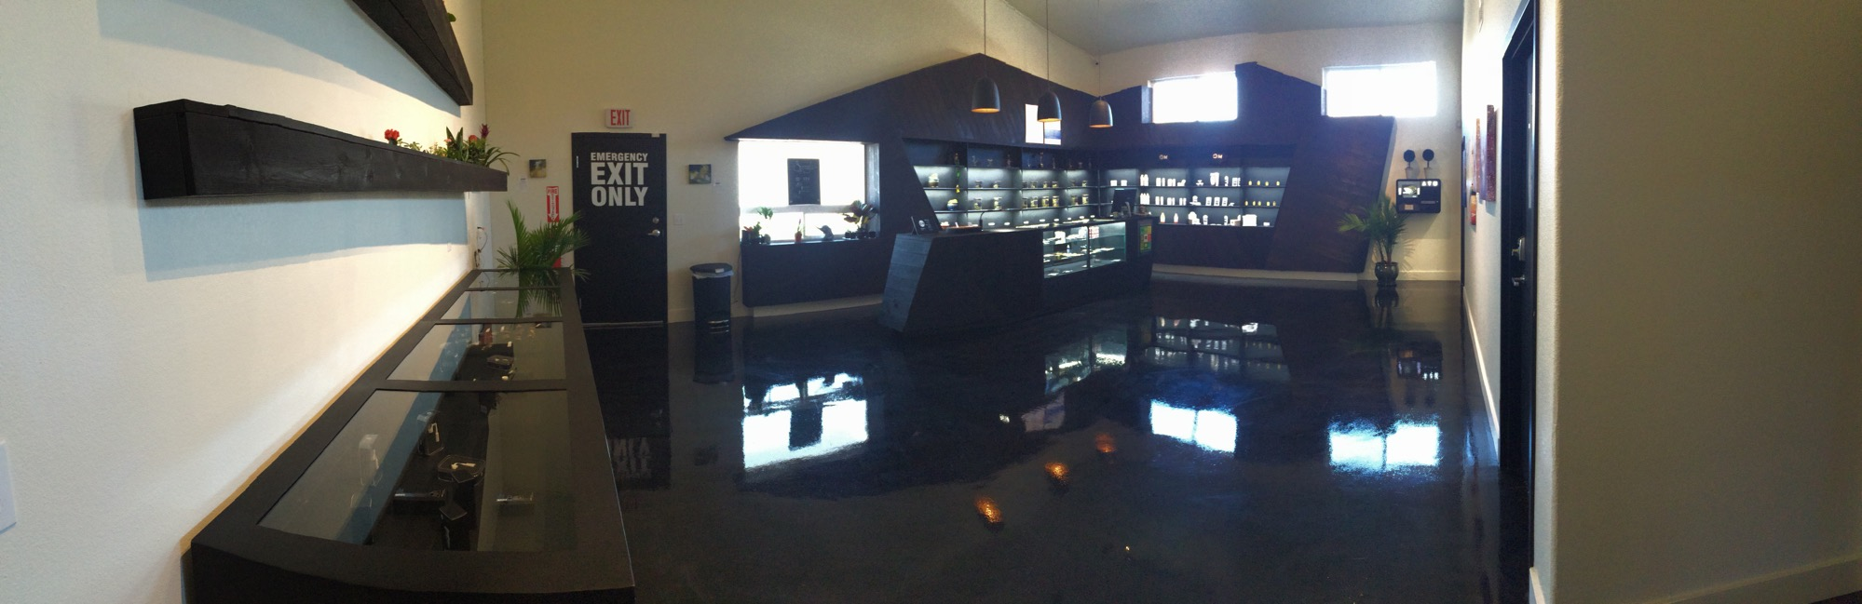

Slide 21
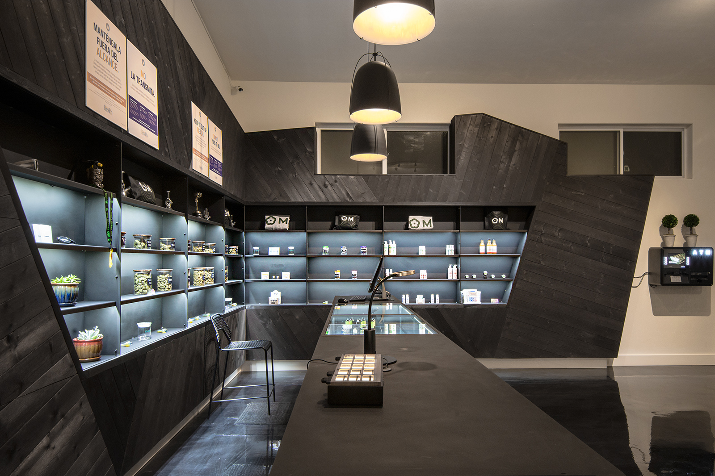

Slide 22
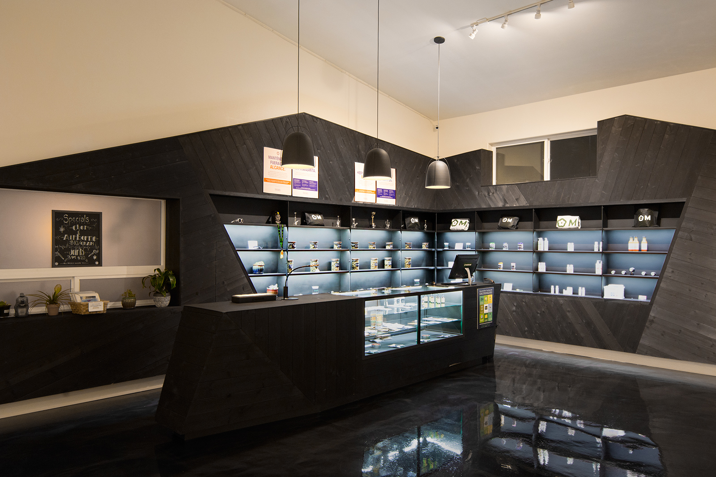

Slide 23
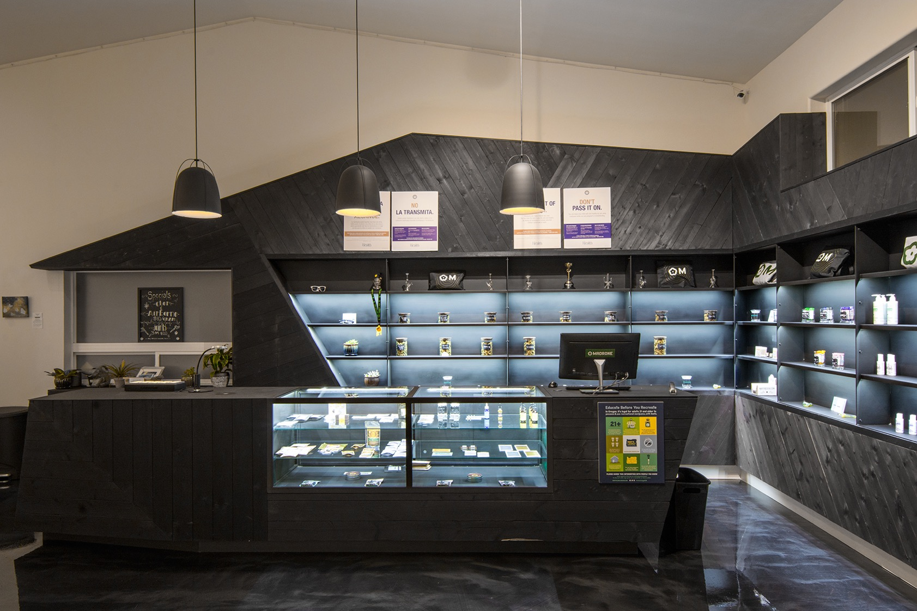

Slide 24
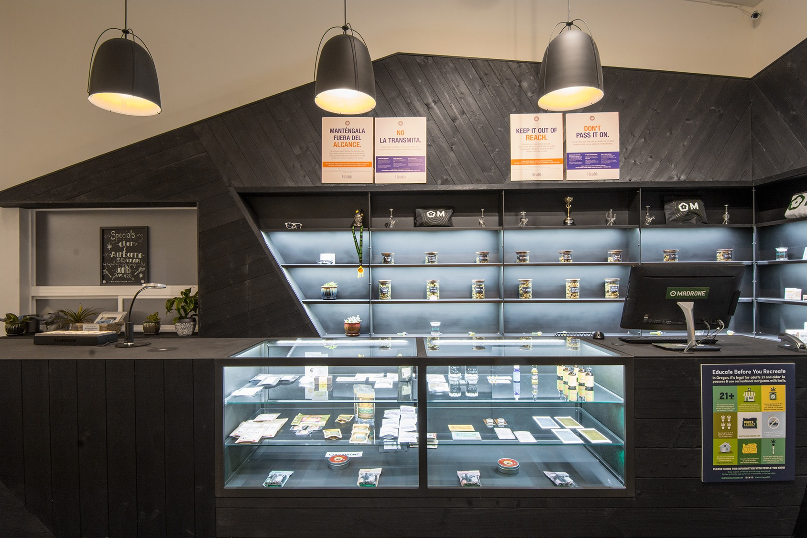

Slide 25
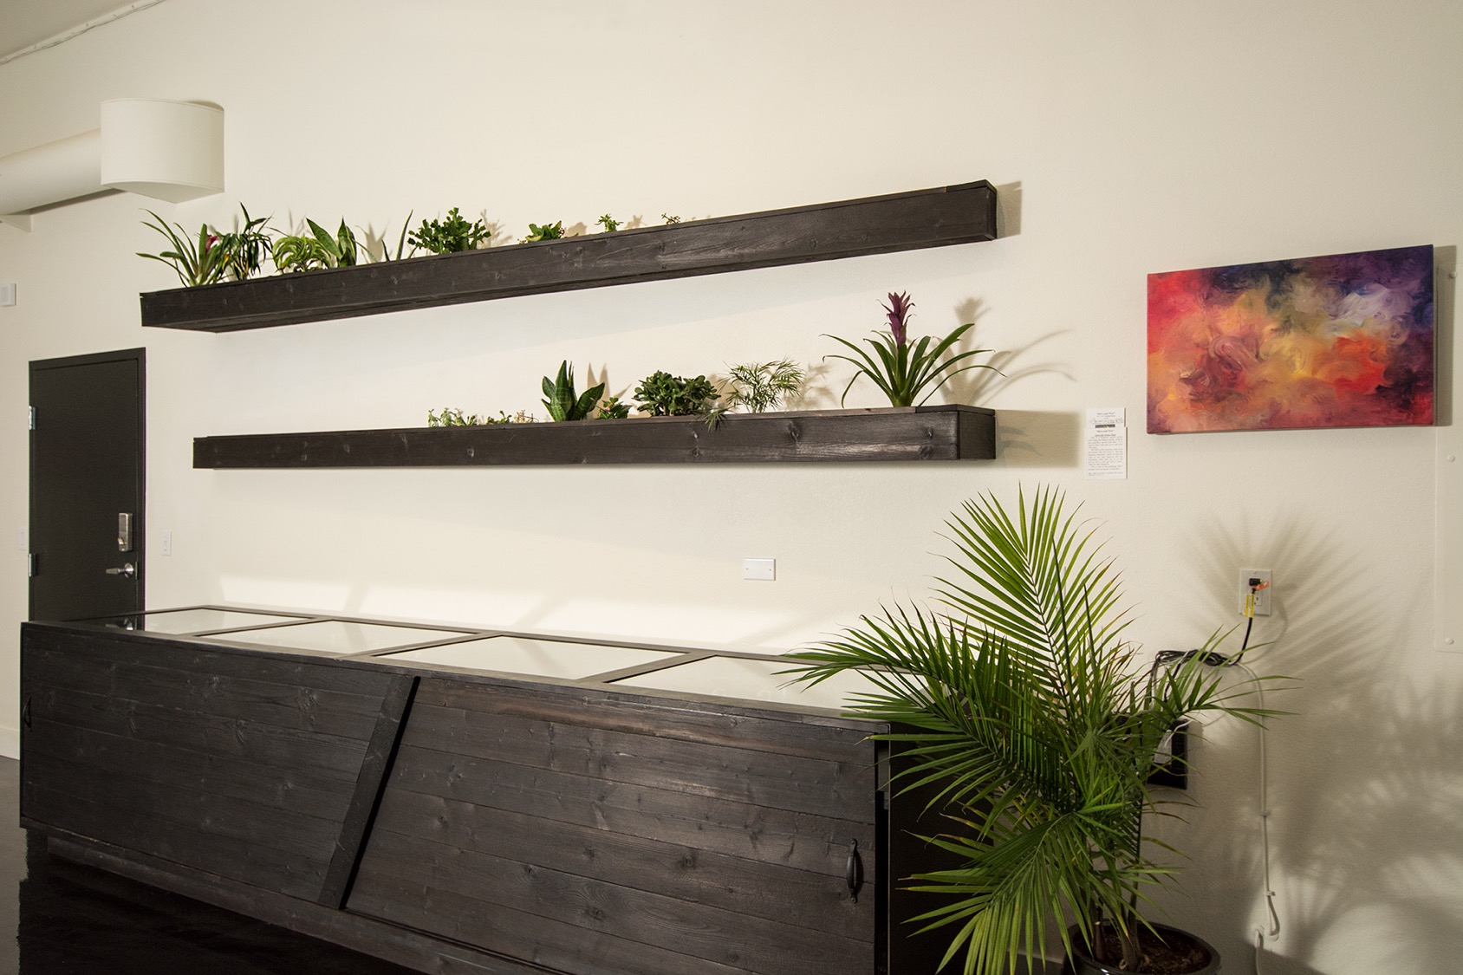

Slide 26
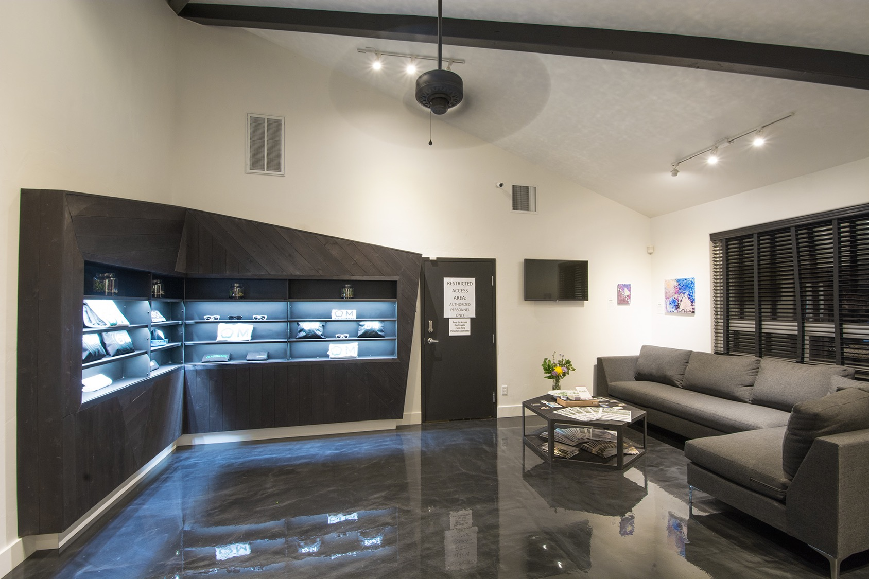

Slide 27
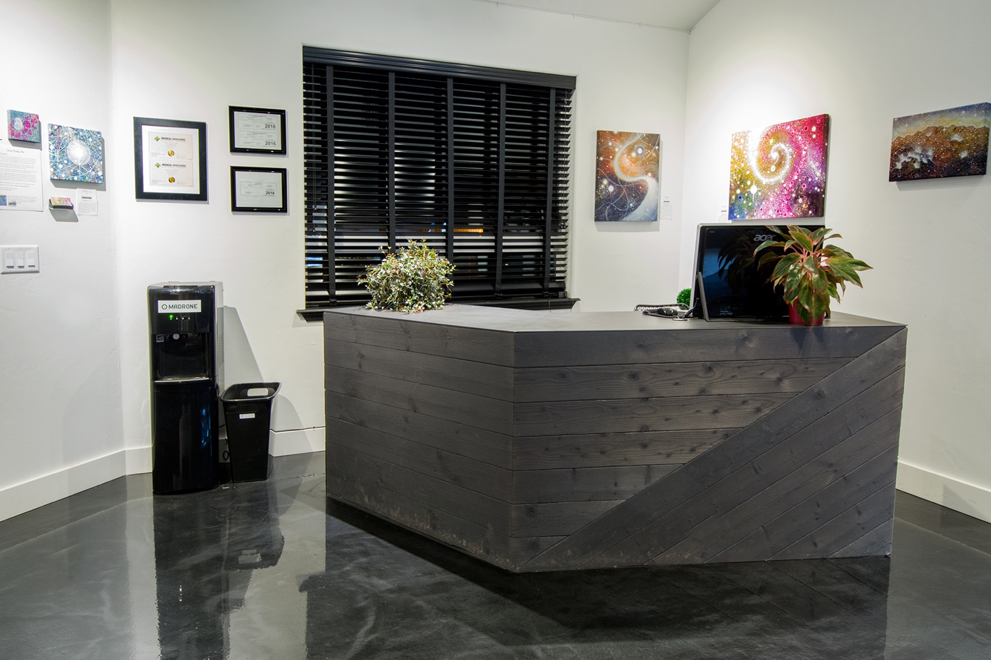

Slide 28
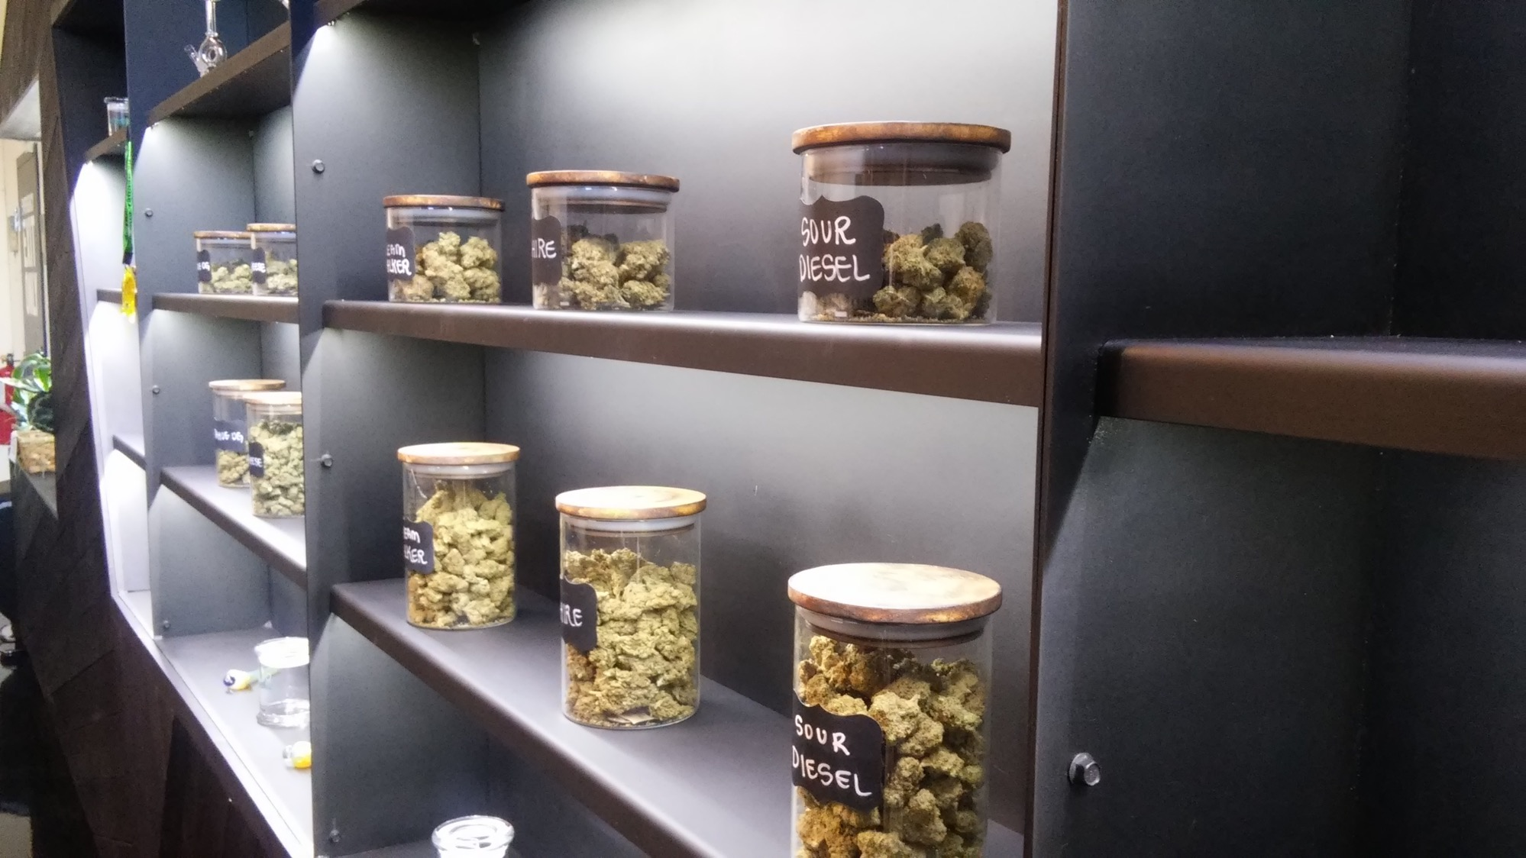

Slide 29


MaxWood Co. was born out of a retired musician’s desire to continue living creatively without traveling in a van 10 months out of the year. After 10 years of filling gaps in touring by making a buck in the more crude elements of building, I found myself working in woodshops for different industries including high fashion show rooms, sports action trade show builds, creative installations, and restaurant builds. Through this journey I became accustomed to different aesthetics spanning from rustic to ultra sleek modern. In this, I found a great love for high end furniture design, and a conscious, well thought out approach to building and presentation.
With a clear direction, I took the plunge, and started amassing tools for a 150 square foot carriage house in my humble San Diego backyard. From here began the great challenge of delivering an increasingly more demanding product in both scale and quality. In the span of three years MaxWood Co. has grown from my garage, to a 2,500 square foot shared shop, to what is now our own fully operational 5,000 square foot multi-media shop. We maintain a small staff, each knowledgeable, and a force in their own right. Somehow it still manages to feel small at times.

Slide 30
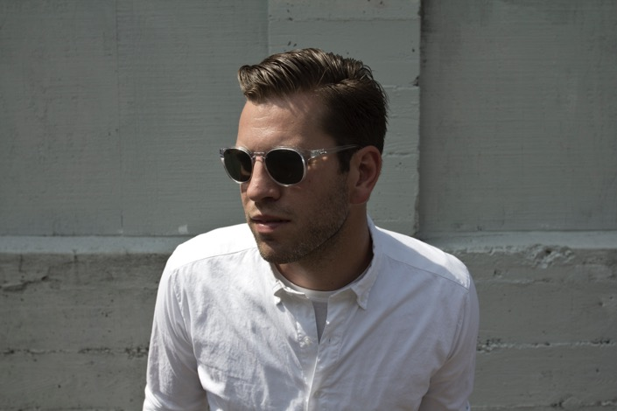
Each year MaxWood Co. has been in operation has had some type of theme. The garage was the incubation period. The shared space was fueled with boots on the ground style hard work. 2015 was carried by great opportunities and the desire to deliver 110%. It was reactionary, chaotic, and successful. Our output jumped 10 times from that of the year before.
2016 is the year of focus. The key elements are in place. The clients are happy, and our staff is inspired. We are building our in-house design capabilities, and focusing more energy into our own product design which will be displayed in our show room that is currently underway on Adams Avenue in San Diego, CA.

Slide 31
Contact us:
MaxWood Co.
maxwood.co
3358 F. Street
San Diego, CA 92102
510-541-1487
info@maxwood.co

